Slide 1

Listeners in TestNG

Slide 2
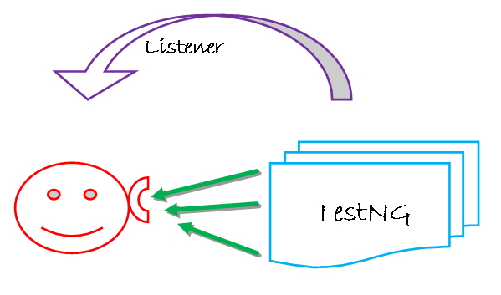
Introduction
Listener is defined as interface that modifies the default TestNG's behavior.
Listeners "listen" to the event defined in the selenium script and behave accordingly.
Listener is used in selenium by implementing Listeners Interface.
Listener allows customizing TestNG reports or logs.

Slide 3
Types of Listeners in TestNG
The few TestNG listeners are:-
IAnnotationTransformer ,
IAnnotationTransformer2 ,
IConfigurable ,
IConfigurationListener ,
IExecutionListener,
IHookable ,
IInvokedMethodListener ,
IInvokedMethodListener2 ,
IMethodInterceptor ,
IReporter,
ISuiteListener,
ITestListener

Slide 4
ITestListener in TestNG
ITestListener has following methods:-
OnStart- This method is called when any Test starts.
onTestSuccess- This method is called on the success of any Test.
onTestFailure- This method is called on the failure of any Test.
onTestSkipped- This method is called on skipped of any Test.
onTestFailedButWithinSuccessPercentage- This method is called each time Test fails but is within success percentage.
onFinish- This method is called after all Tests are executed.

Slide 5
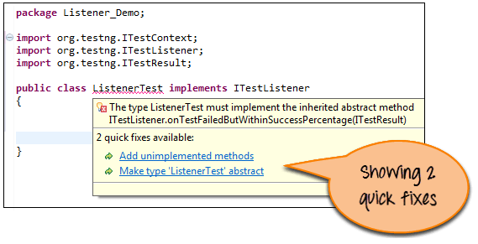
Implementation of TestNG Listener
Example:- Login to the application
Step 1) Create class "ListenerTest" and implements 'ITestListener '. Move the mouse over redline text, and Eclipse will suggest two quick fixes as shown in below screen.
Just click on "Add unimplemented methods". Multiple unimplemented methods (without a body) is added to the code.

Slide 6
Now modify following methods- “onTestFailure, onTestSkipped, onTestStart, onTestSuccess”
See the code here:-
package Listener_Demo;
import org.testng.ITestContext;
import org.testng.ITestListener;
import org.testng.ITestResult;
public class ListenerTest implements ITestListener {
@Override
public void onFinish(ITestContext Result)
{
}
@Override
public void onStart(ITestContext Result)
{
}
@Override
public void onTestFailedButWithinSuccessPercentage(ITestResult Result)
{
}
// When Test case get failed, this method is called.
@Override
public void onTestFailure(ITestResult Result)
{
System.out.println("The name of the testcase failed is :"+Result.getName());
}

Slide 7
Step 2) Create another class "TestCases" for the login process and implement listener in it.
// When Test case get Skipped, this method is called.
@Override
public void onTestSkipped(ITestResult Result)
{
System.out.println("The name of the testcase Skipped is :"+Result.getName());
}
// When Test case get Started, this method is called.
@Override
public void onTestStart(ITestResult Result)
{
System.out.println(Result.getName()+" test case started");
}
// When Test case get passed, this method is called.
@Override
public void onTestSuccess(ITestResult Result)
{
System.out.println("The name of the testcase passed is :"+Result.getName());
}
}

Slide 8
Now See the code here:-
package Listener_Demo;
import org.openqa.selenium.By;
import org.openqa.selenium.WebDriver;
import org.openqa.selenium.firefox.FirefoxDriver;
import org.testng.Assert;
import org.testng.annotations.Listeners;
import org.testng.annotations.Test;
@Listeners(Listener_Demo.ListenerTest.class)
public class TestCases {
WebDriver driver= new FirefoxDriver();
//Test to pass as to verify listeners.
@Test
public void Login()
{
driver.get(URL);
driver.findElement(By.name("uid")).sendKeys("mngr34926");
driver.findElement(By.name("password")).sendKeys("amUpenu");
driver.findElement(By.id("")).click();
}
//Forcefully failed this test as verify listener.
@Test
public void TestToFail()
{
System.out.println("This method to test fail");
Assert.assertTrue(false);
}
}

Slide 9
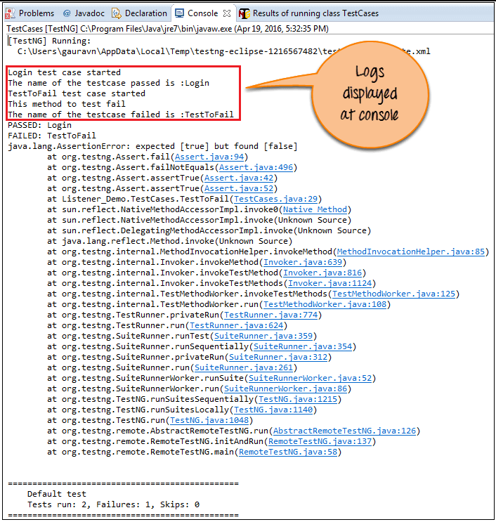
Step 3) Execute the "TestCases " class. Methods in class "ListenerTest "are called automatically according to the behavior of methods annotated as @Test.
Step 4) Verify the Output that logs displays at the console.

Slide 10
Covered Till Now
Listeners are required to generate logs or customize TestNG reports in Selenium Webdriver.
There are many types of TestNG listeners and can be used as per requirements.
Listeners are interfaces used in selenium web driver script.
Demonstrated the use of Listener in Selenium.

Slide 11
Thanks

